Slide 1
The emotiopolitical neural and opinion adaptor machine concept
as it might be realised in this course
by me

Slide 2
Neural Adaptation
Neurons exposed to a constant/continuous stimulus adapt to it, lowering the response evoked to the given stimulus. All stimuli different to the adapted one are often perceived stronger than they really are.

Slide 3
Neural Adaptation
Adaptation to patterns, colors, flavours, haptic stimuli, …
Emotions, feelings, life circumstances and phases, dreams & desires

Slide 4
Neural Adaptation
Media Adaptation
Adaptation to patterns, colors, flavours, haptic stimuli, …
Making opinions, creating attitudes
Emotions, feelings, life circumstances and phases, dreams & desires

Slide 5
Neural Adaptation
Media Adaptation
Adaptation to patterns, colors, flavours, haptic stimuli, …
Making opinions, creating attitudes
PROBLEM!
Emotions, feelings, life circumstances and phases, dreams & desires

Slide 6
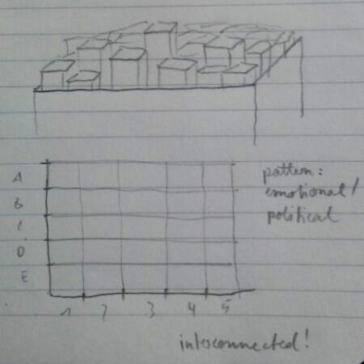
The Adaptor
Fed by digital news (tags, frequently used words, phrases, combinations, …)
Transfer them to a grid of emotional/political set of values

Slide 7
The Adaptor
Fed by digital news (tags, frequently used words, phrases, combinations, …)
Transfer them to a grid of emotional/political set of values
Make blocks respond in real time

Slide 8
The Adaptor
Fed by digital news (tags, frequently used words, phrases, combinations, …)
Transfer them to a grid of emotional/political set of values
Make blocks respond in real time
The system can never reach its initial point as all blocks are interconnected

